Slide 1
Ajax
Asynchronous JavaScript + XML
Mark Andreessen, Netscape, 1995: "MS Windows will be reduced to
a poorly debugged set of device drivers running under Netscape
Navigator, with desktop-style applications running inside the browser".
This did not happen until 10 years later (true/false?)
© 2007-2016 Marco Papa & Ellis Horowitz

Slide 2
Asynchronous JavaScript + XML
Ajax isn’t a technology.
It’s really several technologies. Ajax incorporates:
  standards-based presentation using XHTML;
  CSS, dynamically manipulated using JavaScript;
  dynamic display and interaction using the Document Object Model (DOM). Web page exposed as DOM object;
  data interchange using XML and data manipulation using XSLT (not supported by all browsers);
  asynchronous data retrieval using XMLHttpRequest, a JavaScript object, a.k.a “Web remoting”;
  JavaScript binding everything together;
  Server no longer performs display logic, only business logic.
Acronym originated by Jesse James Garrett
© 2007-2016 Marco Papa & Ellis Horowitz

Slide 3
Some History and Browsers Supporting Ajax
The XMLHttpRequest object is the main element of Ajax programming
Microsoft first implemented the XMLHttpRequest object in Internet Explorer 5 for Windows as an ActiveX object.
Similar functionality is covered in a recommended W3C standard, Document Object Model (DOM) Level 3 Load and Save Specification (April 2004):
http://www.w3.org/TR/DOM-Level-3-LS
Engineers on the Mozilla project implemented a compatible native version for Mozilla 1.0 (included in Netscape 7, Firefox 1.0 and later releases). Apple has done the same starting with Safari 1.2.
Other browsers supporting XMLHttpRequest include:
  Opera 7.6+, Apple Safari 1.2+, All Mobile browsers
XMLHttpRequest is being standardized by the W3C. Working Draft for Level 1 available at:
  http://www.w3.org/TR/XMLHttpRequest/
© 2007-2016 Marco Papa & Ellis Horowitz

Slide 4
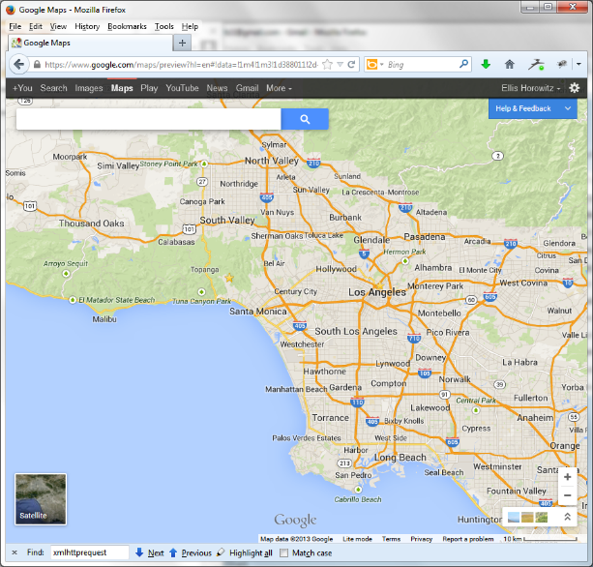
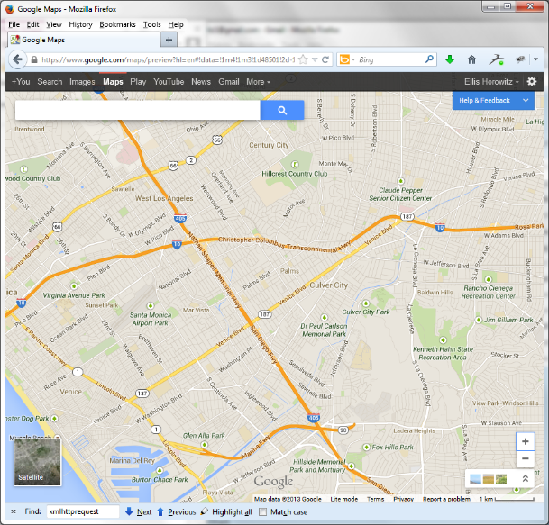
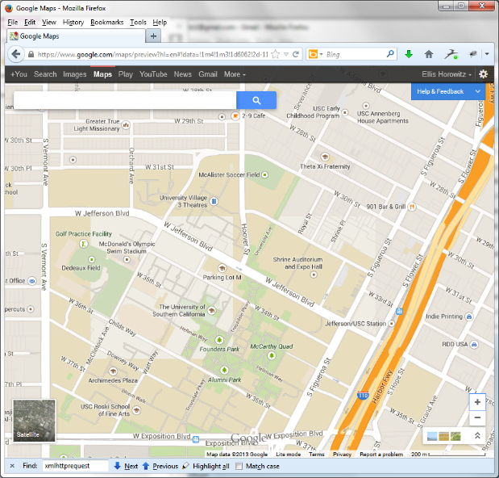
An Example Using Ajax - Google Maps
Initial screen zoom 3 times drag map east
and zoom
Notice that the page is never explicitly refreshed
View source and search for XMLHttpRequest;
You will find multiple occurrences
© 2007-2016 Marco Papa & Ellis Horowitz

Slide 5
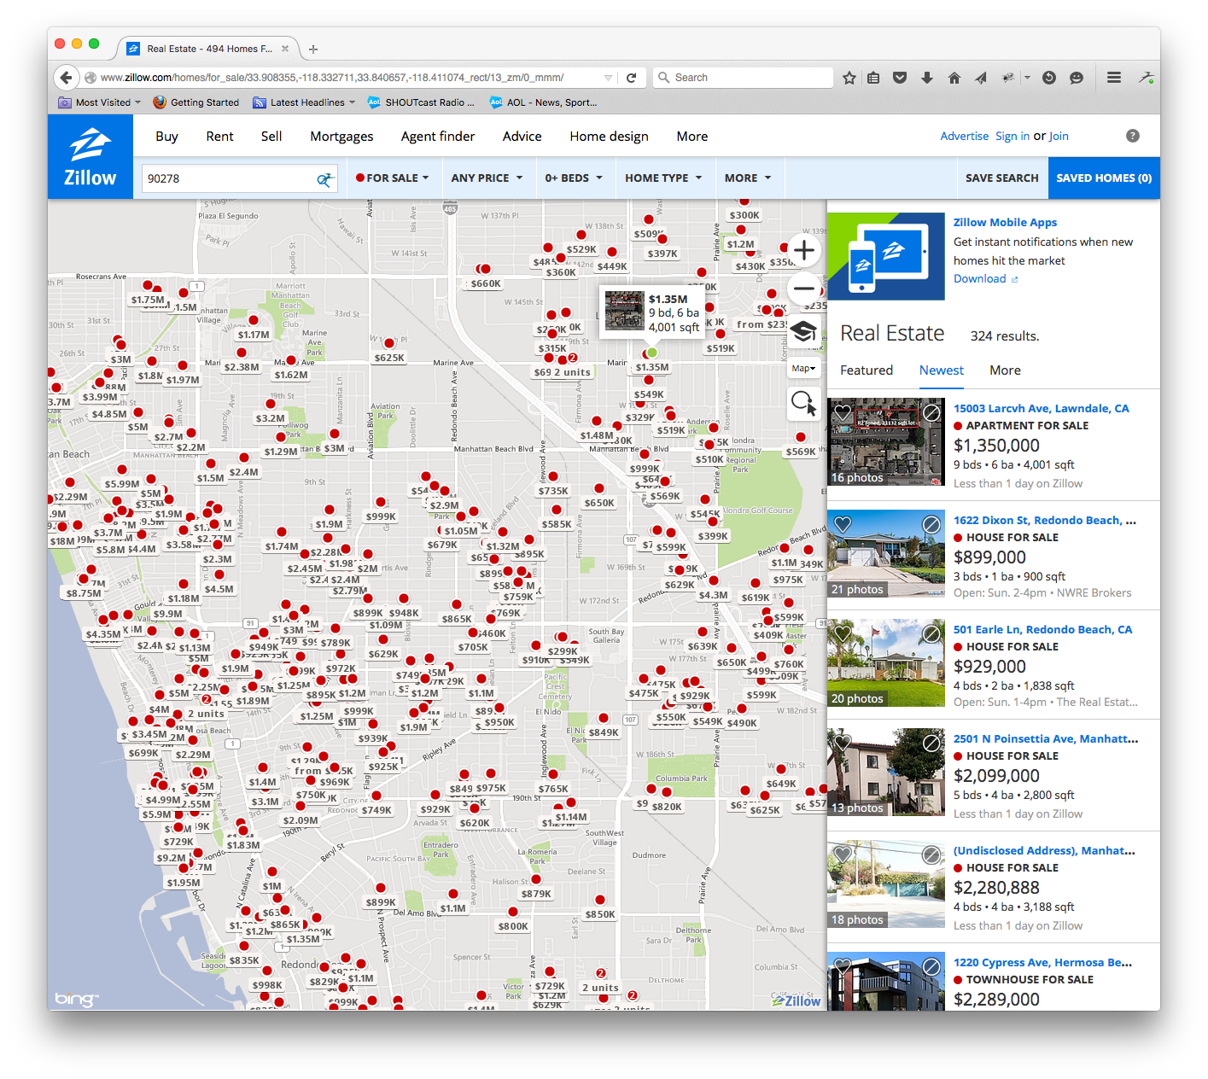
Mashup Example – www.zillow.com
A Mash-Up Combines Multiple Sources of Data
A “mash-up” is a web application that consumes ("remixes")
content from different sources and aggregates them to create a new application
A combination of satellite
photos with records of home
sale prices placed on top of
the appropriate houses
© 2007-2016 Marco Papa & Ellis Horowitz

Slide 6
Characteristics of Ajax Applications
They are applications, not just web sites
They allow for smooth, continuous interaction
"Live" content
Visual Effects
Animations, dynamic icons
Single keystrokes can lead to server calls
New Widgets (selectors, buttons, tabs, lists)
New Styles of Interaction (drag-and-drop, keyboard shortcuts, double-click)
© 2007-2016 Marco Papa & Ellis Horowitz

Slide 7
Comparing Traditional vs. AJAX Websites
Traditional
Interface construction is mainly the responsibility of the server
User interaction is via form submissions
An entire page is required for each interaction (bandwidth)
Application is unavailable while an interaction is processing (application speed)
Ajax
Interface is manipulated by client-side JavaScript manipulations of the Document Object Model (DOM)
User interaction via HTTP requests occur ‘behind the scenes’
Communication can be restricted to data only
Application is always responsive
© 2007-2016 Marco Papa & Ellis Horowitz

Slide 8
How to Recognize an Ajax Application Internally
“View Source” in the browser and search for:
Javascript code that invokes any of these APIs:
  XMLHttpRequest or ActiveXObject("Microsoft.XMLHTTP")
JavaScript that “loads” other JavaScript code (files with .js extension)
XML code passed as text strings to a server, such as ‘<?xml version="1.0"><page>…</page>’
Javascript <script> sections that embed code between //<![CDATA[ and //]]>
JavaScript code that creates IFRAMEs, such as window.document.createElement("iframe")
© 2007-2016 Marco Papa & Ellis Horowitz

Slide 9
The Classic Web Application Model
Most user actions in the browser interface trigger an HTTP request back to a web server.
The server does some processing — retrieving data, crunching numbers, talking to various legacy systems.
The server then returns an HTML page to the client.
Approach issues:
  It doesn’t make for a great user experience.
  While the server is doing its thing, the user is waiting.
  And at every step in a task, the user waits some more.
© 2007-2016 Marco Papa & Ellis Horowitz

Slide 10
The Ajax Web Application Model
Ajax introduces an intermediary — an Ajax engine — between the user and the server.
Instead of loading a webpage, at the start of the session, the browser loads an Ajax engine — written in JavaScript and usually stored in a hidden frame.
This engine is responsible for
  rendering the interface the user sees
  communicating with the server on the user’s behalf.
The Ajax engine allows the user’s interaction with the application to happen asynchronously — independent of communication with the server.
Approach Benefits:
  An Ajax application eliminates the start-stop-start-stop nature of interaction on the Web.
  The user is never staring at a browser window with hourglass, waiting for the server to do something.
  The application is more responsive.
© 2007-2016 Marco Papa & Ellis Horowitz

Slide 11
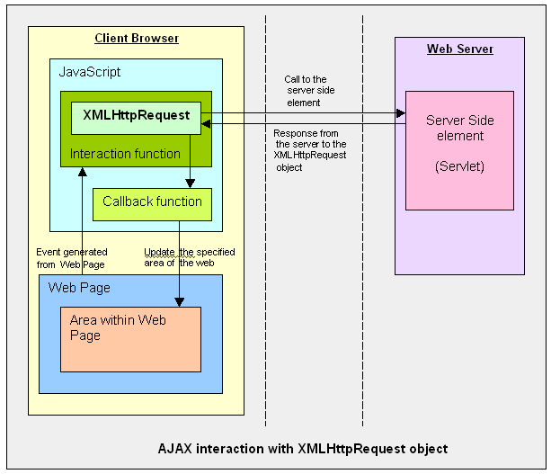
AJAX:
Cuts down on user wait time
Uses client to offload some work from the server
Asynchronous operation
© 2007-2016 Marco Papa & Ellis Horowitz

Slide 12
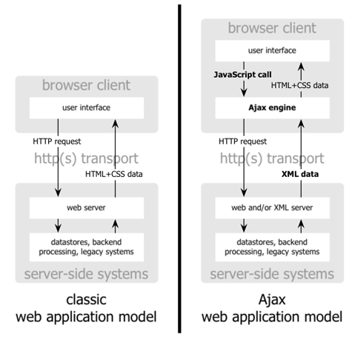
Traditional Web Applications Model compared to the Ajax Model
© 2007-2016 Marco Papa & Ellis Horowitz

Slide 13
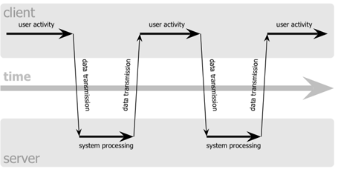
Classic Web Application Model (synchronous)
© 2007-2016 Marco Papa & Ellis Horowitz

Slide 14
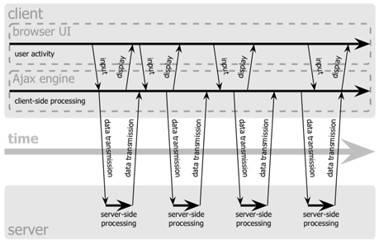
Ajax Web Application Model
(asynchronous)
© 2007-2016 Marco Papa & Ellis Horowitz

Slide 15
Ajax Engine Role
Every user action that normally would generate an HTTP request takes the form of a JavaScript call to the Ajax engine instead.
Any response to a user action that doesn’t require a trip back to the server, such as:
  simple data validation
  editing data in memory
  even some navigation
the engine handles on its own.
If the engine needs something from the server in order to respond, such as:
  submitting data for processing
  loading additional interface code
  retrieving new data
the engine makes those requests asynchronously, usually using XML, without stalling a user’s interaction with the application.
© 2007-2016 Marco Papa & Ellis Horowitz

Slide 16
Initiating the XMLHttpRequest Object
Creating an instance of the XMLHttpRequest object requires branching syntax to account for browser differences in the way instances of the object are generated. For Safari, Chrome, FF, IE 9+ a simple call to the object's constructor function does the job:
var req = new XMLHttpRequest();
For Internet Explorer 5-8, pass the name of the object to the ActiveX constructor:
var req = new ActiveXObject("Microsoft.XMLHTTP");
The object reference returned by both constructors is to an abstract object that works entirely out of view of the user. Its methods control all operations, while its properties hold, among other things, various data pieces returned from the server.
© 2007-2016 Marco Papa & Ellis Horowitz

Slide 17
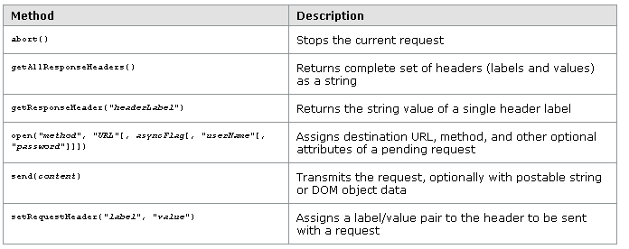
XMLHttpRequest Object Methods
© 2007-2016 Marco Papa & Ellis Horowitz

Slide 18
XMLHttpRequest Object Methods (cont’d)
Of the methods shown in the Table on the previous slide, the open() and send() methods are the ones you'll likely use most.
open() sets the scene for an upcoming operation. Two required parameters are the HTTP method you intend for the request and the URL for the connection. For the method parameter, use "GET" on operations that are primarily data retrieval requests; use "POST" on operations that send data to the server, especially if the length of the outgoing data is potentially greater than 512 bytes. The URL may be either a complete or relative URL.
It is safer to send asynchronously and design your code around the onreadystatechange event for the request object.
© 2007-2016 Marco Papa & Ellis Horowitz

Slide 19
XMLHttpRequest Example Code
var req;
function loadXMLDoc(url) {
req = false;
// branch for native XMLHttpRequest object
if(window.XMLHttpRequest) {
try { req = new XMLHttpRequest();
} catch(e) { req = false;
}
// branch for IE/Windows ActiveX version
} else if(window.ActiveXObject) {
try {
req = new ActiveXObject("Msxml2.XMLHTTP");
} catch(e) {
try { req = new ActiveXObject("Microsoft.XMLHTTP");
} catch(e) { req = false;
}
}
}
if(req) {
req.onreadystatechange = processReqChange;
req.open("GET", url, true);
req.send("");
}
}
This code instantiates an
XmlHttpRequest object
depending upon the browser
© 2007-2016 Marco Papa & Ellis Horowitz

Slide 20
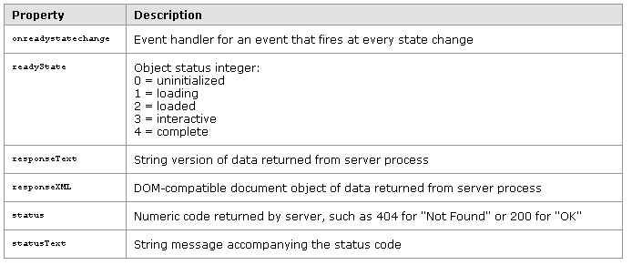
XMLHttpRequest Object Properties
© 2007-2016 Marco Papa & Ellis Horowitz

Slide 21
XMLHttpRequest Object Properties (cont’d)
Use the readyState property inside the event handler function that processes request object state change events. While the object may undergo interim state changes during its creation and processing, the value that signals the completion of the transaction is 4.
Access data returned from the server via the responseText or responseXML properties. The former provides only a string representation of the data. More powerful, however, is the XML document object in the responseXML property. This object is a full-fledged document node object (a DOM nodeType of 9), which can be examined and parsed using W3C Document Object Model (DOM) node tree methods and properties.
Note, however, that this is an XML, rather than HTML, document, meaning that you cannot count on the DOM's HTML module methods and properties. This is not really a restriction because the Core DOM module gives you ample ways of finding element nodes, element attribute values, and text nodes nested inside elements.
© 2007-2016 Marco Papa & Ellis Horowitz

Slide 22
onreadystatechange Event Handler Function
function processReqChange() {
// only if req shows "loaded"
if (req.readyState == 4) {
// only if "OK"
if (req.status == 200) {
// processing statements req.responseText
// and req.responseXML go here...
} else {
alert("There was a problem retrieving the XML data:\n" + req.statusText);
}
}
}
© 2007-2016 Marco Papa & Ellis Horowitz

Slide 23
Security Issues
When the XMLHttpRequest object operates within a browser, it adopts the same-domain security policies of typical JavaScript activity (sharing the same "sandbox," as it were).
First, on most browsers supporting this functionality, the page that bears scripts accessing the object needs to be retrieved via http: protocol, meaning that you won't be able to test the pages from a local hard disk (file: protocol) without some extra security issues cropping up, especially in Mozilla and IE on Windows.
Second, the domain of the URL request destination must be the same as the one that serves up the page containing the script. This means, unfortunately, that client-side scripts cannot fetch web service data from other sources, and blend that data into a page. Everything must come from the same domain.
© 2007-2016 Marco Papa & Ellis Horowitz

Slide 24
AJAX Cross Domain Security
www.other.com
www.other.com
www.myco.com
browser
www.myco.com
browser
www.myco.com
The one exception is for images: images can
come from any domain, without any security
risk.
This is why all the mash-up applications involve
images
They simply would not be possible for other kinds
of data
For security reasons, scripts are
only allowed to access data which
comes from the same domain
© 2007-2016 Marco Papa & Ellis Horowitz

Slide 25
Cross-domain Restrictions and A Solution
Browser security restrictions prevent your web application from opening network connections to domains other than the one your application came from.
For example, suppose your web application wants to use data both from your site and from Yahoo!; normally this is not possible as it is a violation of browser cross-domain security policy.
One way to work around this issue is to install a web proxy on your server that will pass requests from your application to Yahoo! and the data back again.
If you are using a proxy to relay requests from your web application to Yahoo!, the actual request URL you use from your web application is different, as you must relay your request through your web server proxy.
For example, if you are using the PHP Proxy, the actual request looks something like this:
http://www.yourdomain.com/php_proxy_simple.php?WebSearchService/V1/webSearch?appid=YahooDemo&query=persimmon&results=2
where the latter part of the URL is used to access the data on Yahoo!
© 2007-2016 Marco Papa & Ellis Horowitz

Slide 26
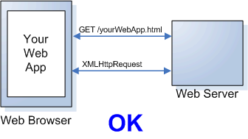
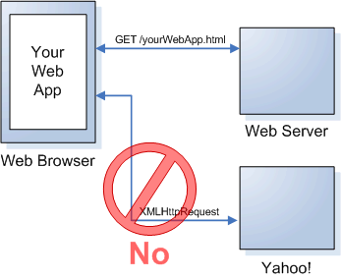
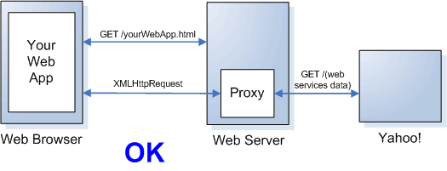
Why You Need a Proxy
© 2007-2016 Marco Papa & Ellis Horowitz

Slide 27
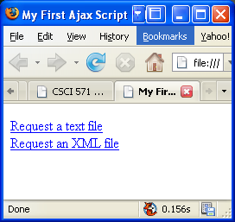
A First Ajax Example – Using Ajax to Download Files
<!DOCTYPE html PUBLIC "-//W3C//DTD XHTML 1.0 Transitional//EN">
<html><head>
<title>First Ajax Script</title>
<script src="script01.js" type="text/javascript" language="Javascript">
</script>
</head><body>
<p><a id="makeTextRequest" href="gAddress.txt">Request a text file</a><br />
<a id="makeXMLRequest" href="us-states.xml">
Request an XML file</a></p>
<div id="updateArea">&nbsp;</div>
</body>
</html>
The javascript file does all of the work
© 2007-2016 Marco Papa & Ellis Horowitz

Slide 28
Imported JavaScript-script01.js
window.onload = initAll;
var xhr = false;
function initAll() {
document.getElementById("makeTextRequest").onclick = getNewFile;
document.getElementById("makeXMLRequest").onclick = getNewFile;}
function getNewFile() {
makeRequest(this.href); return false;}
function makeRequest(url) {
if (window.XMLHttpRequest) { xhr = new XMLHttpRequest();}
else { if (window.ActiveXObject) {
try { xhr = new ActiveXObject("Microsoft.XMLHTTP"); }
catch (e) { }
} }
if (xhr) { xhr.onreadystatechange = showContents;
xhr.open("GET", url, true); xhr.send(null); }
else { document.getElementById("updateArea").innerHTML = "Sorry, but I couldn't create an XMLHttpRequest"; } }
function showContents() {
if (xhr.readyState == 4) {
if (xhr.status == 200) {
var outMsg = (xhr.responseXML && xhr.responseXML.contentType=="text/xml") ? xhr.responseXML.getElementsByTagName("choices")[0].textContent : xhr.responseText;
} else { var outMsg = "There was a problem with the request " + xhr.status; }
document.getElementById("updateArea").innerHTML = outMsg; } }
On page load the onclick event is set to call the function
When the click is made, getNewFile and makerequest are executed.
showContents waits for a successful return of an
file; it then prints the result in the browser
© 2007-2016 Marco Papa & Ellis Horowitz

Slide 29
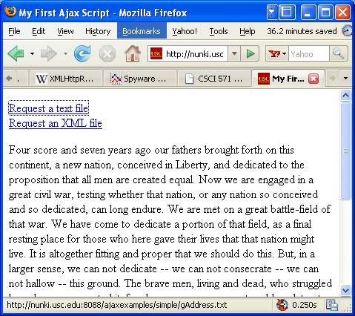
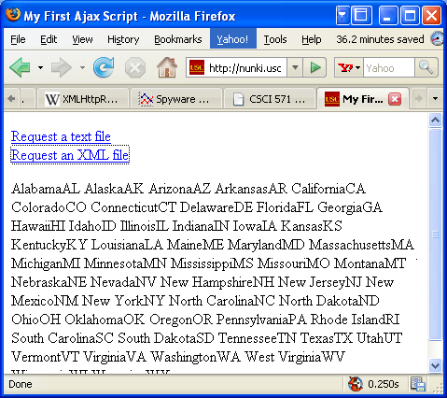
Browser Output
Result of clicking on the
first link
Result of clicking on the
second link
http://cs-server.usc.edu:45678/ajaxexamples/simple/script01.html
© 2007-2016 Marco Papa & Ellis Horowitz

Slide 30
Second Ajax Example – Using Ajax to Download Files from Flickr
Here is the html file, which basically loads script02.js
<!DOCTYPE html PUBLIC "-//W3C//DTD XHTML 1.0 Transitional//EN">
<html><head><title>Second Ajax Script</title>
<script src="script02.js" type="text/javascript" language="Javascript"></script>
</head><body><div id="pictureBar"> </div></body></html>
Here is script02.js
window.onload = initAll;
var xhr = false;
function initAll() {
if (window.XMLHttpRequest) { xhr = new XMLHttpRequest(); }
else { if (window.ActiveXObject) {
try { xhr = new ActiveXObject("Microsoft.XMLHTTP"); } catch (e) { } } }
if (xhr) { xhr.onreadystatechange = showPictures;
xhr.open("GET", "flickrfeed.xml", true); xhr.send(null); }
else { alert("Sorry, but I couldn't create an XMLHttpRequest"); } }
function showPictures() {
var tempDiv = document.createElement("div");
var pageDiv = document.getElementById("pictureBar");
if (xhr.readyState == 4) {
if (xhr.status == 200) {
tempDiv.innerHTML = xhr.responseText;
var allLinks = tempDiv.getElementsByTagName("a");
for (var i=1; i<allLinks.length; i+=2) {
pageDiv.appendChild(allLinks[i].cloneNode(true)); } }
else { alert("There was a problem with the request " + xhr.status); } } }
ShowPictures retrieves an file from flickr;
The result is extracted from responseText and
assigned to innerHTML property
© 2007-2016 Marco Papa & Ellis Horowitz

Slide 31
Portion of Flickr XML file
<?xml version=“1.0” encoding=“utf-8” standalone=“yes”?>
<feed xmlns=http://www.w3.org/2005/Atom
Xmlns=http://purl.org/dc/elements/1.1>
<title>Dori Simth’s Photos</title>
<link rel=“self” href=http://www.flickr.com/services/feeds/photos_public.gne?id=23922109@N00 />
<link rel=“alternate” type=“text/html” href=http://www.flickr.com/photos/dorismith/ />
<id>tag:flickr.com,2005:/photos/public/116078</id>
<icon>http://static.flickr.com/5/buddyicons/23922109@N00.jpg?1113973282</icon>
<subtitle>A feed of Dori Smith’s Photos</subtitle>
<updated>2006-03-22T20:12:44Z</updated>
<generator uri=http://www.flickr.com/>Flickr</generator>
<entry>
<title>Mash note</title>
<link rel=“alternate” type=“text/html” href=http://www.flickr.com/photos/dorismith/116463569/ />
OTHER STUFF
<p> <a href=http://www.flickr.com/photos/dorismith/116463569/ title=“Mash note”><img src=http://static.flickr.com/44/116463569_483fd4ee7c_s.jpg width=“75” height=“75” alt=“Mash note” style=“border: 5px solid #ddd;” /></a> </p>
Each <entry> node has two links;
This application uses the second link so
the showPictures loop starts with 1 rather
than 0 and increments by 2; each link contains
the thumbnail image inside it; every
thumbnail is a link back to the original photo
© 2007-2016 Marco Papa & Ellis Horowitz

Slide 32
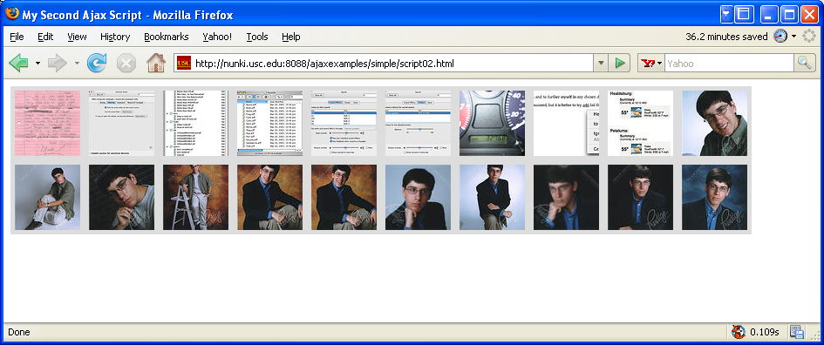
Browser Output
http://cs-server.usc.edu:45678/ajaxexamples/simple/script02.html
© 2007-2016 Marco Papa & Ellis Horowitz

Slide 33
Third Ajax Example - Refreshing Server Data
This extension retrieves a new version of the data from the server, refreshing the page; here is the html accessing javascript
<!DOCTYPE html PUBLIC "-//W3C//DTD XHTML 1.0 Transitional//EN">
<html><head><title>My Third Ajax Script</title>
<script src="script03.js" type="text/javascript" language="Javascript"></script></head>
<body><div id="pictureBar"> </div></body></html>
And here is the source for script03.js
window.onload = initAll;
var xhr = false;
function initAll() { same as previously except it calls getPix }
function getPix() { xhr.open("GET", "flickrfeed.xml", true);
xhr.onreadystatechange = showPictures; xhr.send(null);setTimeout("getPix()",5 * 1000); }
function showPictures() {
var tempDiv = document.createElement("div");
var tempDiv2 = document.createElement("div");
if (xhr.readyState == 4) {
if (xhr.status == 200) {
tempDiv.innerHTML = xhr.responseText;
var allLinks = tempDiv.getElementsByTagName("a");
for (var i=1; i<allLinks.length; i+=2) {
tempDiv2.appendChild(allLinks[i].cloneNode(true)); }
allLinks = tempDiv2.getElementsByTagName("a");
var randomImg = Math.floor(Math.random() * allLinks.length);
document.getElementById("pictureBar").innerHTML = allLinks[randomImg].innerHTML;
} else { alert("There was a problem with the request " + xhr.status); } } }
The call to getPix is placed in setTimeout which causes
repeated execution, every 5 seconds;
An array of links of photographs is created, a random
number computed, and use it as an index into the array
© 2007-2016 Marco Papa & Ellis Horowitz

Slide 34
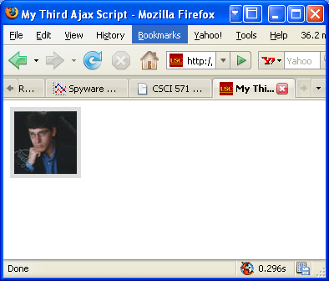

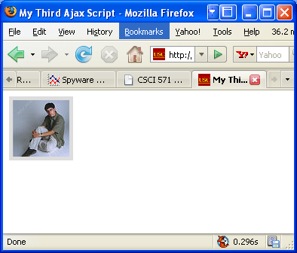
Browser Output
Three consecutive outputs
http://cs-server.usc.edu:45678/ajaxexamples/simple/script03.html
© 2007-2016 Marco Papa & Ellis Horowitz

Slide 35
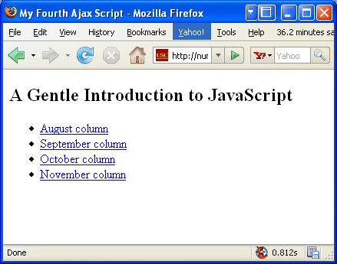
Fourth Ajax Example - Previewing Links
<!DOCTYPE html PUBLIC "-//W3C//DTD XHTML 1.0 Transitional//EN">
<html><head>
<title>My Fourth Ajax Script</title>
<link rel="stylesheet" rev="stylesheet" href="script04.css" />
<script src="script04.js" type="text/javascript" language="Javascript">
</script>
</head><body>
<h2>A Gentle Introduction to JavaScript</h2><ul>
<li><a href="jsintro/2000-08.html">August column</a></li>
<li><a href="jsintro/2000-09.html">September column</a></li>
<li><a href="jsintro/2000-10.html">October column</a></li>
<li><a href="jsintro/2000-11.html">November column</a></li>
</ul>
<div id="previewWin"> </div>
</body>
</html>
http://cs-server.usc.edu:45678/ajaxexamples/simple/script04.html
© 2007-2016 Marco Papa & Ellis Horowitz

Slide 36
The stylesheet
#previewWin {
background-color: #FF9;
width: 400px;
height: 100px;
font: .8em arial, helvetica, sans-serif;
padding: 5px;
position: absolute;
visibility: hidden;
top: 10px;
left: 10px;
border: 1px #CC0 solid;
clip: auto;
overflow: hidden;
}
#previewWin h1, #previewWin h2 {
font-size: 1.0em;
}
© 2007-2016 Marco Papa & Ellis Horowitz

Slide 37
The javascript source
window.onload = initAll;
var xhr = false;
var xPos, yPos;
function initAll() {
var allLinks = document.getElementsByTagName("a");
for (var i=0; i< allLinks.length; i++) {
allLinks[i].onmouseover = showPreview; } }
function showPreview(evt) { getPreview(evt); return false; }
function hidePreview() {
document.getElementById("previewWin").style.visibility = "hidden"; }
function getPreview(evt) {
if (evt) { var url = evt.target; }
else { evt = window.event; var url = evt.srcElement; }
xPos = evt.clientX; yPos = evt.clientY;
if (window.XMLHttpRequest) {
xhr = new XMLHttpRequest(); }
else { if (window.ActiveXObject) {
try { xhr = new ActiveXObject("Microsoft.XMLHTTP"); } catch (e) { } } }
if (xhr) { xhr.onreadystatechange = showContents;
xhr.open("GET", url, true); xhr.send(null);
} else { alert("Sorry, but I couldn't create an XMLHttpRequest"); } }
© 2007-2016 Marco Papa & Ellis Horowitz

Slide 38
The javascript source cont’d
function showContents() {
var prevWin = document.getElementById("previewWin");
if (xhr.readyState == 4) {
prevWin.innerHTML = (xhr.status == 200) ? xhr.responseText : "There was a problem with the request " + xhr.status;
prevWin.style.top = parseInt(yPos)+2 + "px";
prevWin.style.left = parseInt(xPos)+2 + "px";
prevWin.style.visibility = "visible";
prevWin.onmouseout = hidePreview; }}
Notes: initall goes through all of the links and adds an onmouseover event;
showPreview( ) and hidePreview( ) are both needed; the latter sets the preview window
back to hidden;
In getPreview( ), depending upon the browser, the URL is in either evt.target or
in window.event.srcElement; the (x,y) position is extracted;
In showContents( ) the data is placed in prevWin.innerHTML from responseText;
The preview window is placed just below and to the right of the cursor position that triggered the call
© 2007-2016 Marco Papa & Ellis Horowitz

Slide 39
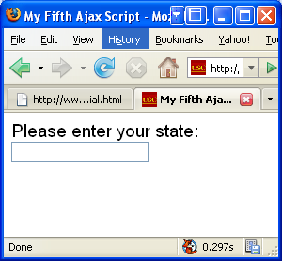
Fifth Ajax Example, Auto Completion
<!DOCTYPE html PUBLIC "-//W3C//DTD XHTML 1.0 Transitional//EN">
<html><head><title>My Fifth Ajax Script</title>
<link rel="stylesheet" rev="stylesheet" href="script05.css" />
<script src="script05.js" type="text/javascript" language="Javascript">
</script>
</head><body>
<form action="#">
Please enter your state:<br />
<input type="text" id="searchField" autocomplete="off" /><br />
<div id="popups"> </div>
</form></body></html>
Autocomplete attribute is set to off to prevent browsers
from trying to autocomplete the field
Initial screen
© 2007-2016 Marco Papa & Ellis Horowitz

Slide 40
The stylesheet
body, #searchfield {
font: 1.2em arial, helvetica, sans-serif;
}
.suggestions {
background-color: #FFF;
padding: 2px 6px;
border: 1px solid #000;
}
.suggestions:hover {
background-color: #69F;
}
#popups {
position: absolute;
}
#searchField.error {
background-color: #FFC;
}
© 2007-2016 Marco Papa & Ellis Horowitz

Slide 41
The JavaScript Source
Onkeyup captures single keystrokes
window.onload = initAll;
var xhr = false; var statesArray = new Array();
function initAll() {
document.getElementById("searchField").onkeyup = searchSuggest;
if (window.XMLHttpRequest) { xhr = new XMLHttpRequest(); }
else { if (window.ActiveXObject) {
try { xhr = new ActiveXObject("Microsoft.XMLHTTP"); } catch (e) { } }}
if (xhr) {
xhr.onreadystatechange = setStatesArray;
xhr.open("GET", "us-states.xml", true); xhr.send(null);
} else { alert("Sorry, but I couldn't create an XMLHttpRequest"); }}
function setStatesArray() {
if (xhr.readyState == 4) {
if (xhr.status == 200) {
if (xhr.responseXML) {
var allStates = xhr.responseXML.getElementsByTagName("item");
for (var i=0; i<allStates.length; i++) {
statesArray[i] = allStates[i].getElementsByTagName("label")[0].firstChild; } } }
else { alert("There was a problem with the request " + xhr.status); } } }
The example uses the xml file listing the states
Here we read the list of states and place them in
an array
© 2007-2016 Marco Papa & Ellis Horowitz

Slide 42
The JavaScript Source cont’d
function searchSuggest() {
var str = document.getElementById("searchField").value;
document.getElementById("searchField").className = "";
if (str != "") {
document.getElementById("popups").innerHTML = "";
for (var i=0; i<statesArray.length; i++) {
var thisState = statesArray[i].nodeValue;
if (thisState.toLowerCase().indexOf(str.toLowerCase()) == 0) {
var tempDiv = document.createElement("div");
tempDiv.innerHTML = thisState;
tempDiv.onclick = makeChoice;
tempDiv.className = "suggestions";
document.getElementById("popups").appendChild(tempDiv); } }
var foundCt = document.getElementById("popups").childNodes.length;
if (foundCt == 0) {
document.getElementById("searchField").className = "error"; }
if (foundCt == 1) {
document.getElementById("searchField").value = document.getElementById("popups").firstChild.innerHTML;
document.getElementById("popups").innerHTML = ""; } } }
function makeChoice(evt) {
var thisDiv = (evt) ? evt.target : window.event.srcElement;
document.getElementById("searchField").value = thisDiv.innerHTML;
document.getElementById("popups").innerHTML = ""; }
This routine is called on a key up;
The value in the search field is first
extracted; if nothing is entered, do
nothing;
If indexof returns 0, then we have a hit;
Add a state to the list of
possibilities
Foundct is the number
of matches
Unique hit, place it in proper place
© 2007-2016 Marco Papa & Ellis Horowitz

Slide 43
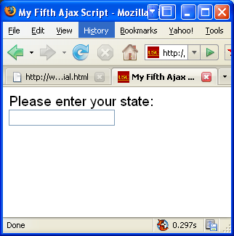
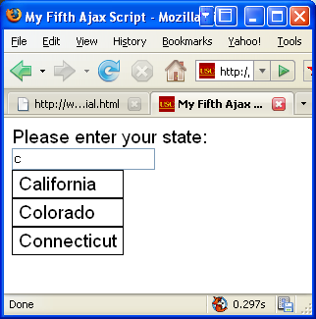
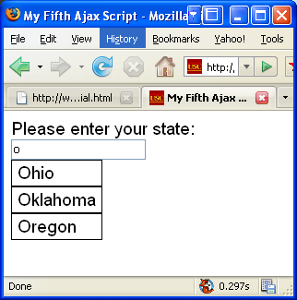
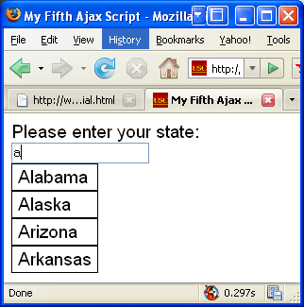
Browser Output
Initial screen
3 examples
http://cs-server.usc.edu:45678/ajaxexamples/simple/script05.html
© 2007-2016 Marco Papa & Ellis Horowitz

Slide 44
Ajax Slide Show Example
We want to create an application that downloads a set of jpg images from a server and shows them in a slide show
We want to avoid the delay that comes from downloading each slide one-at-a-time across the Internet
We use Ajax to control the downloading of slides so that the slide show appears to work smoothly
© 2007-2016 Marco Papa & Ellis Horowitz

Slide 45
PHP Script to Extract Slides
we begin by creating a PhP script for accessing the jpg images
this script can be thought of as providing a simple web service, namely delivering an xml file of images
all images have file names of the form name_width_height.jpg where width and height are numerical values
<?php
header( "Content-type: text/xml" );
?>
<slides>
<?php
if ($handle = opendir('images')) {
while (false !== ($file = readdir($handle)))
{
if ( preg_match( "/[.]jpg$/", $file ) ) {
preg_match( "/_(\d+)_(\d+)[.]/", $file, $found );
?>
<slide src="images/<?php echo $file; ?>"
width="<?php echo $found[1]; ?>"
height="<?php echo $found[2]; ?>" /><?php echo( "\n" ); ?>
<?php
}
}
closedir($handle);
}
?>
</slides>
© 2007-2016 Marco Papa & Ellis Horowitz

Slide 46
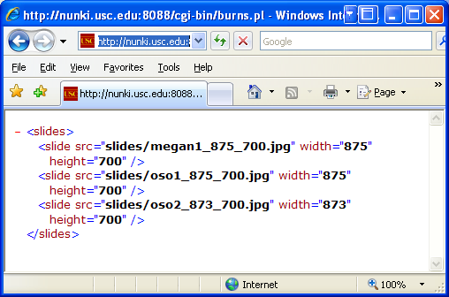
Browser output
© 2007-2016 Marco Papa & Ellis Horowitz

Slide 47
Simple Program to Read Data from the service using Ajax Connection
<html> <body> <script>
function processReqChange() {
if (req.readyState == 4 && req.status == 200 && req.responseXML != null)
{ alert( req.responseText ); } }
function loadXMLDoc( url ) {
req = false;
if(window.XMLHttpRequest) { try { req = new XMLHttpRequest();
} catch(e) { req = false; }
} else if(window.ActiveXObject)
{ try { req = new ActiveXObject("Msxml2.XMLHTTP");
} catch(e) {
try { req = new ActiveXObject("Microsoft.XMLHTTP");
} catch(e) { req = false; } } }
if(req) {
req.onreadystatechange = processReqChange;
req.open("GET", url, true);
req.send(""); } }
loadXMLDoc( "http://nunki.usc.edu:8088/cgi-bin/burns.pl" );
</script> </body> </html>
loadXMLDoc determines how
to invoke XMLHttpRequest and
then sends an Ajax GET request
To execute burns.pl; That request
goes off asynchronously to
retrieve the page and
return the result. When the
request is complete, the
processReqChange
function is called with the
Result which displays the value
of the responseText function
in an alert window.
© 2007-2016 Marco Papa & Ellis Horowitz

Slide 48
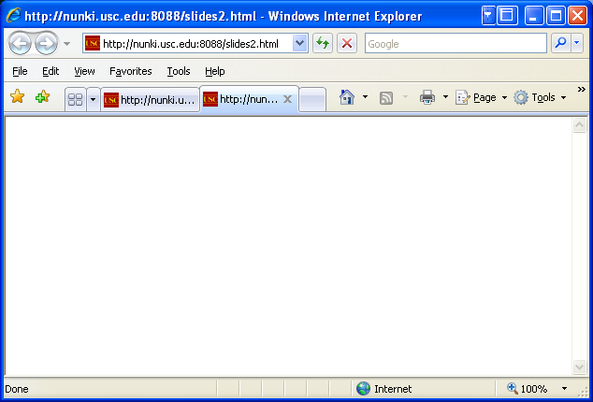
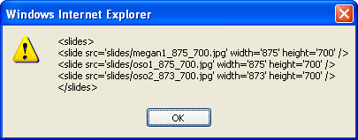
Browser Output
© 2007-2016 Marco Papa & Ellis Horowitz

Slide 49
Notes on the Previous Program
the XML data is successfully coming back from the server.
the URL is an absolute path, domain name and all. That's the only valid URL style for Ajax. The server code that writes the Ajax JavaScript code always creates valid, fully formed URLs.
Ajax security precautions - The JavaScript code can't ask for just any URL. The URL must have the same domain name as the page.
  you can't render HTML from www.mycompany.com, and then have the script retrieve data from data.mycompany.com. Both domains must match exactly, including the sub-domains.
the code in loadXMLDoc, Pre-version 7 Internet Explorer doesn't have the XMLHTTPRequest object type built in. So, one must use Microsoft ActiveX controls.
Finally, in the processReqChange function,
  The readyState value of 4 means that the transaction is complete.
  The status value of 200 means that the page is valid.
© 2007-2016 Marco Papa & Ellis Horowitz

Slide 50
Creating HTML dynamically
Now we extend the current example by having the processReqChange function create an HTML table with the results of the XML request from the server.
In that way, one can test that it is possible to read the XML and create HTML from it dynamically.
© 2007-2016 Marco Papa & Ellis Horowitz

Slide 51
Enhanced Test Page
<html> <body> <table border=1> <tbody id="dataTable"> </tbody> </table>
<script> function processReqChange() {
if (req.readyState == 4 && req.status == 200 && req.responseXML != null) {
var dto = document.getElementById( 'dataTable' );
var items = [ ];
var nl = req.responseXML.getElementsByTagName( 'slide' );
for( var i = 0; i < nl.length; i++ ) {
var nli = nl.item( i );
var src = nli.getAttribute( 'src' ).toString();
var width = parseInt( nli.getAttribute( 'width' ).toString() );
var height = parseInt( nli.getAttribute( 'height' ).toString() );
var trNode = document.createElement( 'tr' );
var srcNode = document.createElement( 'td' );
srcNode.innerHTML = src;
trNode.appendChild( srcNode );
var widthNode = document.createElement( 'td' );
widthNode.innerHTML = width.toString();
trNode.appendChild( widthNode );
The updated processReqChange
code now looks at the responseXML
object instead of the responseText text.
In addition, it uses
getElementsByTagName to access all
the <slide> tags. From there, it parses
the src, width, and height attributes and
uses the createElement method on the
document object to create rows and
cells to hold the data. This method of
using the createElement method is far
more robust than the method in which
you create an HTML string with the
contents of the table and use
innerHTML to add the data to an
existing element.
© 2007-2016 Marco Papa & Ellis Horowitz

Slide 52
Enhanced Test Page (cont’d)
var heightNode = document.createElement( 'td' );
heightNode.innerHTML = height.toString();
trNode.appendChild( heightNode );
dto.appendChild( trNode ); }
load_slides( items );
start_slides(); } }
function loadXMLDoc( url ) {
req = false;
if(window.XMLHttpRequest) {
try { req = new XMLHttpRequest();
} catch(e) {
req = false; }
} else if(window.ActiveXObject) {
try { req = new ActiveXObject("Msxml2.XMLHTTP");
} catch(e) {
try { req = new ActiveXObject("Microsoft.XMLHTTP");
} catch(e) { req = false; } } }
if(req) { req.onreadystatechange = processReqChange;
req.open("GET", url, true);
req.send(""); } }
loadXMLDoc( "http://nunki.usc.edu:8088/cgi-bin/burns.pl" );
</script> </body> </html>
© 2007-2016 Marco Papa & Ellis Horowitz

Slide 53
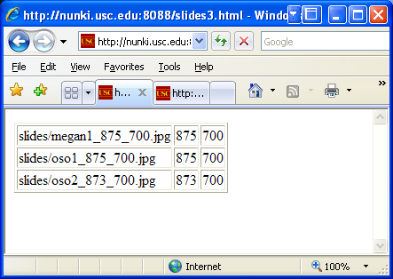
Browser Output
© 2007-2016 Marco Papa & Ellis Horowitz

Slide 54
Some References
Ajax (programming) – Wikipedia: http://en.wikipedia.org/wiki/AJAX
Using the XML HTTP Request object: http://jibbering.com/2002/4/httprequest.html
XMLHttpRequest & Ajax Working Examples: http://www.fiftyfoureleven.com/resources/programming/xmlhttprequest/examples
Very Dynamic Web Interfaces: http://www.xml.com/pub/a/2005/02/09/xml-http-request.html
© 2007-2016 Marco Papa & Ellis Horowitz

Slide 55
Ajax Enabled Technologies (Toolkits)
Ruby on Rails:
http://www.rubyonrails.org/
Microsoft ASP.NET Atlas:
http://www.asp.net/ajax/
Eclipse / IBM -- The AJAX Toolkit Framework (ATF):
http://www.eclipse.org/atf/
Kabuki Ajax Toolkit:
http://www.zimbra.com/community/kabuki_ajax_toolkit_download.html
Yahoo! User Interface Library (DEPRECATED):
http://developer.yahoo.net/yui/
© 2007-2016 Marco Papa & Ellis Horowitz

Slide 56
Browser Security Features
© 2007-2016 Marco Papa & Ellis Horowitz

Slide 57
Credits
The following material is based on the google wiki, Browser Security Handbook:
https://code.google.com/p/browsersec/wiki/Part1
https://code.google.com/p/browsersec/wiki/Part2
Part1 Outline
Basic concepts behind web browsers
  Uniform Resource Locators
    Unicode in URLs
  True URL schemes
  Pseudo URL schemes
  Hypertext Transfer Protocol
  Hypertext Markup Language
    HTML entity encoding
  Document Object Model
  Browser-side Javascript
    Javascript character encoding
  Other document scripting languages
  Cascading stylesheets
    CSS character encoding
  Other built-in document formats
  Plugin-supported content
Part2 Outline
Standard browser security features
  Same-origin policy
    Same-origin policy for DOM access
    Same-origin policy for XMLHttpRequest
    Same-origin policy for cookies
    Same-origin policy for Flash
    Same-origin policy for Java
    Same-origin policy for Silverlight
    Same-origin policy for Gears
    Origin inheritance rules
    Cross-site scripting and same-origin policies
  Life outside same-origin rules
    Navigation and content inclusion across domains
    Arbitrary page mashups (UI redressing)
    Gaps in DOM access control
    Privacy-related side channels
  Various network-related restrictions
    Local network / remote network divide
    Port access restrictions
    URL scheme access rules
    Etc
© 2007-2016 Marco Papa & Ellis Horowitz

Slide 58
Same-origin policy for DOM access
the term "same-origin policy" most commonly refers to a mechanism that governs the ability for Javascript and other scripting languages to access DOM properties and methods across domains
the same-origin model attempts to ensure proper separation between unrelated pages, and serve as a method for sandboxing potentially untrusted or risky content within a particular domain
© 2007-2016 Marco Papa & Ellis Horowitz

Slide 59
Three-Step Decision Process
the model boils down to this three-step decision process:
If protocol, host name, and - for browsers other than Microsoft Internet Explorer - port number for two interacting pages match, access is granted with no further checks.
Any page may set the document.domain parameter to a right-hand, fully-qualified fragment of its current host name (e.g., foo.bar.example.com may set it to example.com, but not ample.com). If two pages explicitly and mutually set their respective document.domain parameters to the same value, and the remaining same-origin checks are satisfied, access is granted.
If neither of the above conditions is satisfied, access is denied.
© 2007-2016 Marco Papa & Ellis Horowitz

Slide 60
Drawbacks of Same-Origin Policy
once any two legitimate subdomains in example.com, e.g. www.example.com and payments.example.com, choose to cooperate, any other resource in that domain, such as user-pages.example.com, may then set its own document.domain likewise, and arbitrarily mess with payments.example.com. This means that in many scenarios, document.domain may not be used safely at all.
Whenever document.domain cannot be used - either because pages live in completely different domains, or because of the above problem - legitimate client-side communication between, for example, embeddable page gadgets, is completely forbidden in theory, and in practice very difficult to arrange
Whenever tight integration of services within a single host name is pursued to overcome these communication problems, because of the inflexibility of same-origin checks, there is no usable method to sandbox any untrusted or particularly vulnerable content to minimize the impact of security problems.
© 2007-2016 Marco Papa & Ellis Horowitz

Slide 61
Special Cases that Are Omitted From the Policy
The document.domain behavior when hosts are addressed by IP addresses, as opposed to fully-qualified domain names, is not specified.
The document.domain behavior with extremely vague specifications (e.g., co.uk) is not specified.
The algorithms of context inheritance for pseudo-protocol windows, such as about:blank, are not specified.
The behavior for URLs that do not meaningfully have a host name associated with them (e.g., file://) is not defined, causing some browsers to permit locally saved files to access every document on the disk or on the web; users are generally not aware of this risk, potentially exposing themselves.
The behavior when a single name resolves to vastly different IP addresses (for example, one on an internal network, and another on the Internet) is not specified, permitting various attacks and tricks
© 2007-2016 Marco Papa & Ellis Horowitz

Slide 62
Same-origin policy for XMLHttpRequest
security-relevant features provided by XMLHttpRequest
  The ability to specify an arbitrary HTTP request method (via the open() method),
  The ability to set custom HTTP headers on a request (via setRequestHeader()),
  The ability to read back full response headers (via getResponseHeader() and getAllResponseHeaders()),
  The ability to read back full response body as Javascript string (via responseText property).
© 2007-2016 Marco Papa & Ellis Horowitz

Slide 63
Checks on XMLHttpRequest
The set of checks implemented in all browsers for XMLHttpRequest is a close variation of DOM same-origin policy, with the following changes:
Checks for XMLHttpRequest targets do not take document.domain into account, making it impossible for third-party sites to mutually agree to permit cross-domain requests between them.
In some implementations, there are additional restrictions on protocols, header fields, and HTTP methods for which the functionality is available, or HTTP response codes which would be shown to scripts (see later).
© 2007-2016 Marco Papa & Ellis Horowitz

Slide 64
Cross-origin resource sharing (CORS)
Cross-origin resource sharing (CORS) allows many resources (e.g, fonts, JavaScript, etc.) on a web page to be requested across domains.
In particular, AJAX calls can use XMLHttpRequest across domains. Such “cross-domain” requests would otherwise be forbidden by web browsers.
The CORS standard adds new HTTP headers. To initiate a CORS request, a browser sends the request with an “Origin” HTTP header. Suppose a page from http://www.social-network.com attempts to access user data from online-personal-calendar.com. If the browser supports CORS, this header is sent:
Origin: http://www.social-network.com
If the server at online-personal-calendar.com allows the request, it sends an Access-Control-Allow-Origin (ACAO) header in the response. The value of the header indicates what origin sites are allowed. For example:
Access-Control-Allow-Origin: http://www.social-network.com
If the server does not allow the CORS request, the browser will deliver an error instead of the online-personal-calendar.com response. Firefox 3.5+, Safari 4+, Chrome3+, IE 10+, Opera 12+ support CORS. See:
https://developer.mozilla.org/en-US/docs/Web/HTTP/Access_control_CORS
http://enable-cors.org/server_apache.html
© 2007-2016 Marco Papa & Ellis Horowitz

Slide 65
Problems and Drawbacks with Cookies
Privacy issues: the chief concern with the mechanism was that it permitted scores of users to be tracked extensively across any number of collaborating domains without permission
Problems with ccTLDs: the specification did not account for the fact that many country-code TLDs are governed by odd or sometimes conflicting rules. For example, waw.pl, com.pl, and co.uk should be all seen as generic, functional top-level domains,
Problems with conflict resolution: when two identically named cookies with different scopes are to be sent in a single request, there is no information available to the server to resolve the conflict and decide which cookie came from where, or how old it is
Problems with certain characters: just like HTTP, cookies have no specific provisions for character escaping, and no specified behavior for handling of high-bit and control characters
Problems with cookie jar size: standards do relatively little to specify cookie count limits or pruning strategies. Various browsers may implement various total and per-domain caps, and the behavior may result in malicious content purposefully disrupting session management, or legitimate content doing so by accident.
© 2007-2016 Marco Papa & Ellis Horowitz

Slide 66
Same-Origin Policy for Flash
Adobe Flash is a plugin believed to be installed on about 99% of all desktops, incorporates a security model generally inspired by browser same-origin checks.
Flash applets have their security context derived from the URL they are loaded from
Within this realm, permission control follows the same basic principle as applied by browsers to DOM access:
  protocol, host name, and port of the requested resource is compared with that of the requestor, with universal access privileges granted to content stored on local disk.
© 2007-2016 Marco Papa & Ellis Horowitz

Slide 67
Same-Origin Policy for Java
Much like Adobe Flash, Java applets, reportedly supported on about 80% of all desktop systems, follow the basic concept of same-origin checks applied to a runtime context derived from the site the applet is downloaded from
the following permissions are available to Java applets:
  The ability to interact with Javascript on the embedding page through the JSObject API, with no specific same-origin checks. This mechanism is disabled by default, but may be enabled with the MAYSCRIPT parameter within the <APPLET> tag.
  In some browsers, the ability to interact with the embedding page through the DOMService API. The documentation does not state what, if any, same-origin checks should apply; based on the aforementioned tests, no checks are carried out, and cross-domain embedding pages may be accessed freely with no need for MAYSCRIPT opt-in. This directly contradicts the logic of JSObject API.
  The ability to send same-origin HTTP requests using the browser stack via the URLConnection API, with virtually no security controls, including the ability to set Host headers, or insert conflicting caching directives. On the upside, it appears that there is no ability to read 30x redirect bodies or httponly cookies from within applets.
  The ability to initiate unconstrained TCP connections back to the originating host, and that host only, using the Socket API. These connections do not go through the browser, and are not subject to any additional security checks (e.g., ports
© 2007-2016 Marco Papa & Ellis Horowitz

